Slide 1
The Hutton Junior Fisheries Biology Program
MENTOR
ORIENTATION

Slide 2
Content Overview
Introduction to the Hutton Program
Code of Conduct
Hutton Program Requirements, Rules and Responsibilities
Addressing Issues

Slide 3
The “Hutton Program” is a mentoring & internship program for high school students designed to stimulate career interest in fisheries among young people and attract underrepresented groups to the profession, such as minorities and women.
Students, known as Hutton Scholars, are mentored by fisheries professionals while getting an exciting, hands-on experience in a marine or freshwater setting.
Each student is awarded a $4,000 award!

Slide 4
CONGRATULATIONS!
You are now officially part of the American Fisheries Society’s Hutton Junior Fisheries Biology Program as a Hutton Mentor. Your commitment indicates that you believe the Hutton Program mission in diversifying and stimulating interest in the fisheries profession.
As a Mentor, you recognize the magnitude of the responsibility that you accepted in choosing to work with youth and agree to interact appropriately with your Mentee, known as a Hutton Scholar, according to the highest ethical standards at all times.
Remember to always be yourself!
Please read the following program guidelines and code of conduct carefully.

Slide 5
HUTTON PROGRAM GUIDELINES AND CODE OF CONDUCT
Our Scholar, is PHENOMENAL and participating at a level above expectation. She has no fear and are willing to jump right in to any situation, learn and assist with the program needs.”
- Brent Nichols, Elliot Kittel and Alix Blake

Slide 6
Your Role as a Mentor:
As a professional, be encouraged to share and advise your student, but know your limitations.
Set realistic expectations and goals for your Hutton Scholar
Encourage your Hutton Scholar to complete his/her secondary education and pursue higher learning or vocational goals; provide access to varying points of view. Assist in making the connection between his/her actions of today and the dreams and goals of tomorrow
Establish how you can reach your Hutton Scholar (phone, e-mail, etc.)
Identify the Hutton Scholar interests and take them seriously. Be alert for opportunities and teaching moments. Explore positive and negative consequences.
Respect the uniqueness and honor the integrity of your Hutton Scholar and influence him/her through constructive feedback.
Be supportive of the parent/guardians involvement in the Hutton Scholar activities.
Remember to be patient!

Slide 7
Code of Conduct
The Hutton Program requires all mentors use the following guidelines:
On very rare occasions, your Mentee may need to be dismissed from the site because of unacceptable behavior. Before taking this action, tell him/her what you are doing and why you made the decision.
Dismissing your Mentee because of his/her behavior doesn’t necessarily mean the match (relationship) has ended. Before the dismissal, the Mentee understand that he/she will see you again and that you are not using his/her behavior as a pretext to abandon the relationship.
Never physically discipline.
Never use abusive language.
Don’t use ultimatums.
Discuss your concerns. Most youths will listen and respond to reason. Explain to your Mentee why you find his/her behavior unacceptable.

Slide 8
HUTTON PROGRAM RULES
AND RESPONSIBILITIES
“The Hutton program has increased my interest in fisheries and increased my awareness of fisheries’ significance to the marine ecosystem, the economy, and the world as a whole.”
- Jennifer Z.

Slide 9
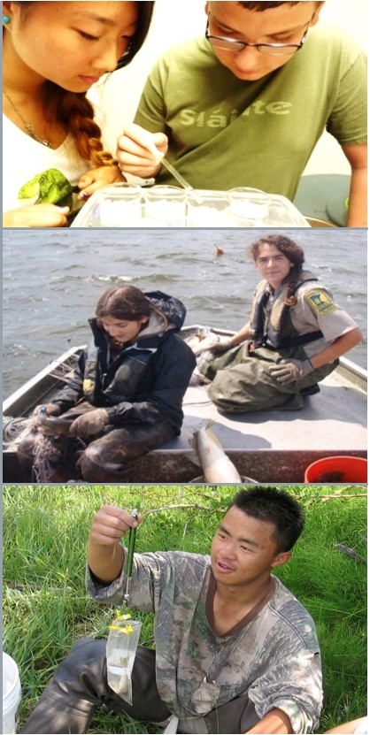
MENTOR RESPONSIBILITIES
It is your responsibility to take the first step in planning activities is primarily; however, ask your Hutton Scholar to help make decisions or have him/her plan an activity.
Assume responsibility for one’s personal and professional actions and conduct.
Mentors are to ensure their Hutton Scholar complete 8-weeks of the program to be eligible to receive the scholarship funds.
Adhere to the agreed-upon reporting schedule, and notify the assigned Hutton Scholar at least 7 days in advance of any need to change the schedule or need to be absent.
Maintain employment standing at the assigned Mentor Institution for the duration of the volunteer assignment.
Notify the AFS Educational Program Coordinator of any health concerns or on-site injury.

Slide 10
MENTOR REQUIREMENTS
Hutton Mentors are required to submit an initial and final report on their Hutton Scholar and overall Hutton Program experience.
Hutton Mentors are required to complete an EXIT SURVEY on their overall Hutton Program experience.
Hutton Mentors are required to complete a biweekly time-sheet.
Timesheets are to be by approved by the Student’s reporting Mentor and submitted at set deadline to the AFS Educational Program Coordinator in order to receive a bi-weekly stipend of $1000.
Hutton Mentors are required to send photos and videos to AFS. Media release forms must be completed prior to submission. The Educational Program Coordinator will provide set deadlines, media release forms, and further instructions via email.
Note: All volunteer work products shall be the exclusive property of AFS
Guidelines, Forms and timelines will be provided on the Hutton Program website.

Slide 11
TRAVEL REQUIREMENTS
Hutton Mentors may provide Hutton Scholars with transportation associated with field work.
No overnight stays are allowed without a signed consent form from the Hutton Scholar and his/her parent/guardian. You must sign and complete AFS’ Overnight Travel Form. The Mentor is responsible for sending a copy of a signed parental and Mentee permission form to AFS Hutton Program Coordinator.
Travel per diem food expenses for the Hutton Scholar for overnight trips are not covered by AFS.
NOTE: The Hutton Program does not support outside costs in addition to the scholar's scholarship award.
Guidelines, Forms and timelines will be provided on the Hutton Program website.

Slide 12
EXPENSES
Mentors receive no salary provisions .
The Hutton Mentor is considered a volunteer and is not entitled to compensation or overtime during any portion of this assignment.
Any cost incurred associated with training the student or self will not be covered by AFS.
Travel per diem food expenses for the Hutton Scholar for overnight trips are not covered by AFS.
Any Hutton Scholar expenses associated with travel while on the job (overnight field trips, etc.) are voluntarily paid for by the Mentor’s office.
NOTE: The Hutton Program does not support outside costs in addition to the scholar's scholarship award.
Guidelines, Forms and timelines will be provided on the Hutton Program website.

Slide 13
Health and Safety
The Hutton Program provides liability insurance for coverage up for each student. As the liability insurance policy has a very high minimum number of individuals that it covers, we are able to cover all mentors as well at no additional cost.
The Hutton Program requires all mentors use the following guidelines:
Do not use alcohol, tobacco or drugs when with your Mentee.
Do not have firearms or weapons, that aren't an institutional requirement for the task, while with your Mentee.
Always wear seat belts while in the car.
Ensure your Mentee has all the necessary protective items and is well supervised on outings.

Slide 14
ADDRESSING ISSUES
“Our Hutton Scholar is simply outstanding! She has developed her own research project to determine if nonnative crayfish outcompete native crayfish. In addition to this research, she is working with other faculty to learn more about contemporary issues in fisheries and aquatic ecology. She is also interested in animal behavior so she is spending two days in the field with a deer biologist study behavior of does and fawns.”
- Craig Paukert

Slide 15
ADDRESSING ISSUES: Termination
Hutton Scholars may be subjected to being terminated from the program. Termination may be the result of a variety of situations:
Sometimes it may become necessary to terminate a Hutton Scholar scholarship award stipend due to conflicts between the Mentee and Mentor.
Sometimes termination may occur because either the Mentee or the Mentor drops out of the program.
Sometimes it may become apparent that the Mentee and/or Mentor may work more effectively with another Mentor/Mentee. In these cases, reassignment may be best.

Slide 16
ADDRESSING ISSUES: Termination
When the decision has been made by the Hutton Program Coordinator with the consent of all parties to end the formal mentoring relationship, remember to take these quick steps when meeting with your Hutton Scholar:
Set a specific date for your last meeting and inform your Hutton Scholar of this ahead of time;
Be honest, candid and supportive, regardless of the reason for the termination;
Talk about the reasons for ending the relationship;
Talk about your thoughts and feelings for the Mentee and your feelings about the termination;
Encourage your Mentee to do the same;
Be positive and supportive, especially about what the future may hold for your Mentee;
Don’t make promises you may not keep (e.g., that you will keep in touch).

Slide 17
FINALLY
ALWAYS REMEMBER
YOU ARE A MENTOR TO…

Slide 18
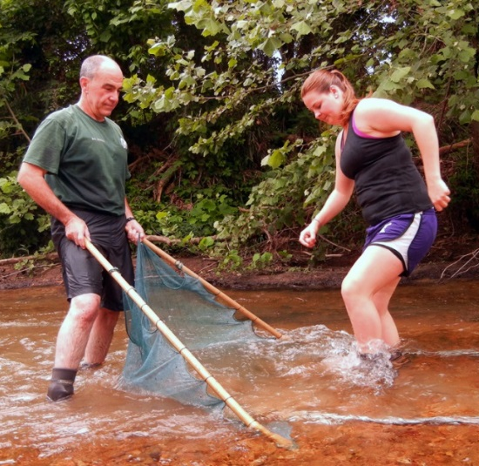
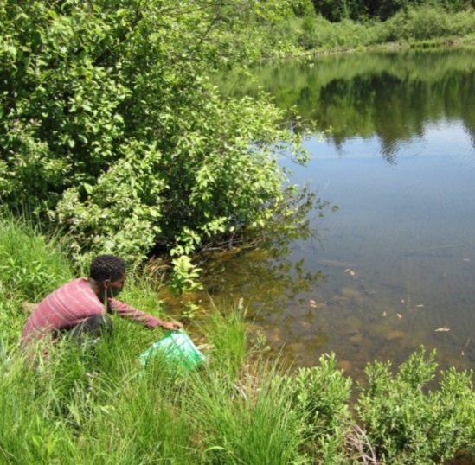
HELP students learn about conservation issues and the importance of healthy aquatic systems.

Slide 19
& ENJOY YOUR SUMMER AS A HUTTON MENTOR! Any additional questions? Please reach out to AFS Educational Program Coordinator, Mary Webb Banning, at mbanning@fisheries.org or (301)897-8616 x204
THANK YOU FOR YOUR SUPPORT

